Slide 1
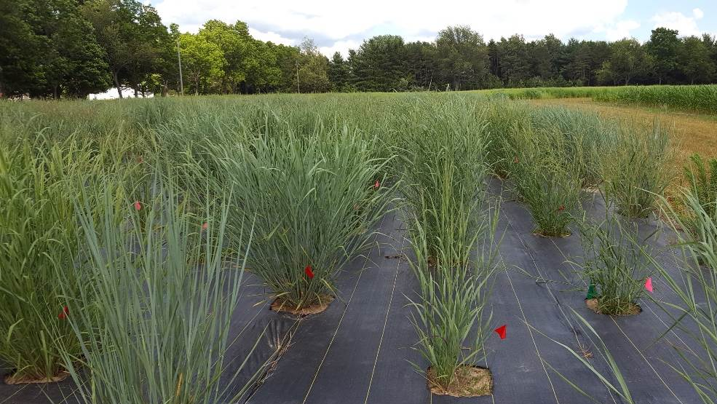
Genetics of Genotype-By-Environment Interactions in the Switchgrass Diversity Panel
Alice MacQueen
BER Plant Genomic Science Workshop
2020-01-13

Slide 2
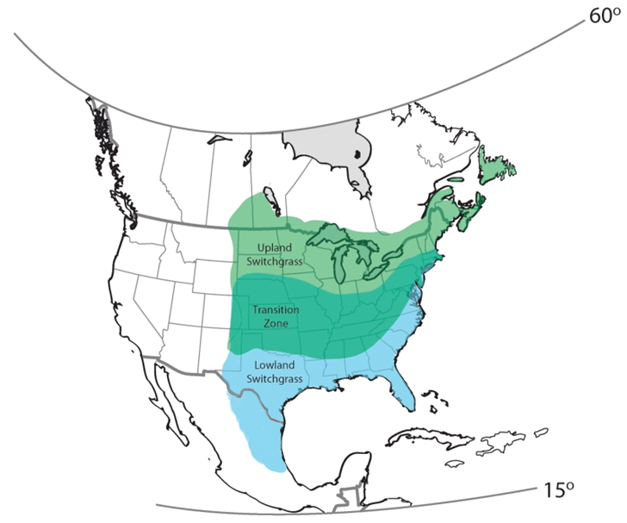
Switchgrass is the model herbaceous bioenergy crop.
Native to North America
Widespread distribution and wide environmental adaptation
Productive on marginal lands
High yielding (7-10 tons dry matter per acre)
If grown on ~5% of land in a 25 mile area, could supply a bioenergy plant 24/7/365
~8 USDA Cold Hardiness Zones
~60 inch variation in Annual Precipitation
Notes:
Typical bioenergy/cellulosic ethanol plant produces 50-million-gallons of ethanol per year
~8 USDA Cold Hardiness Zones
>60 inches of Annual Precipitation

Slide 3
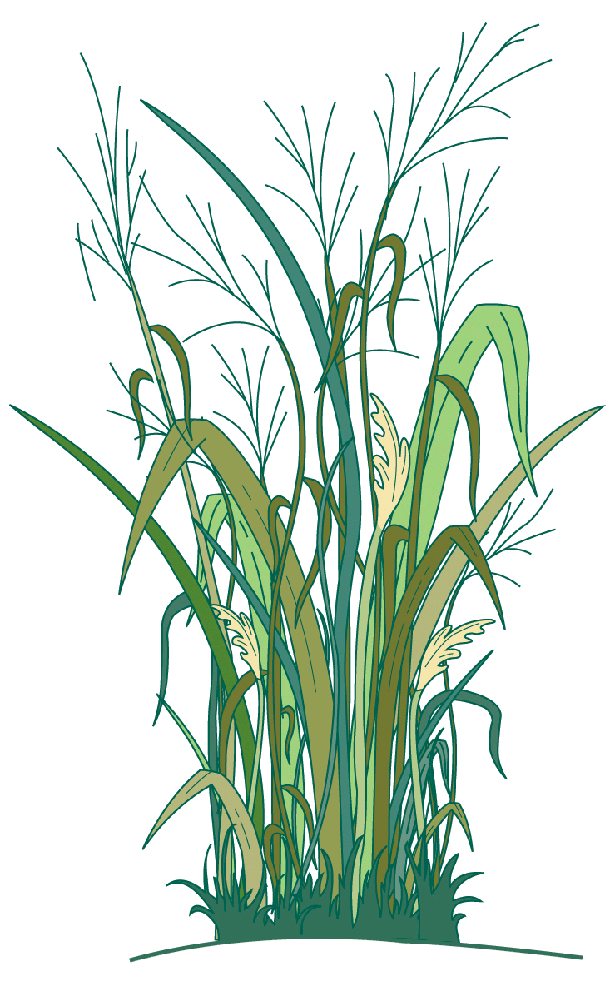
Switchgrass is the model herbaceous bioenergy crop.
Is switchgrass locally adapted to climatic gradients? If so, at what spatial scales?
What are the mechanisms, traits, and genes important for current or future adaptation to climate?
How important are genetic tradeoffs in driving patterns of climate adaptation?

Slide 4
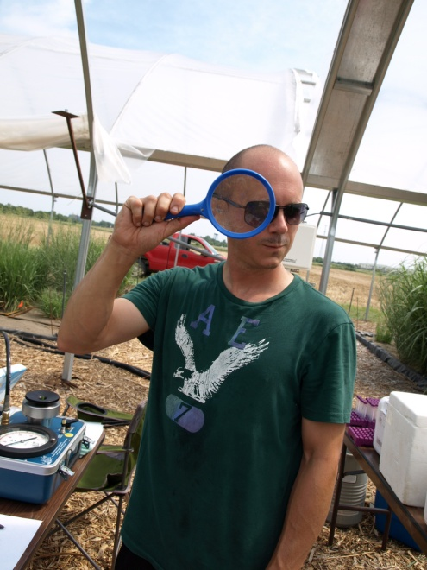





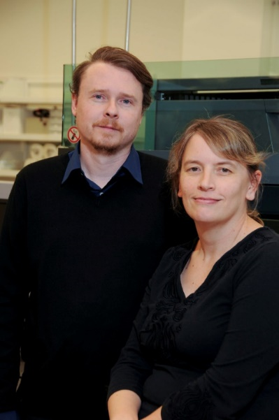



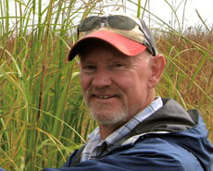
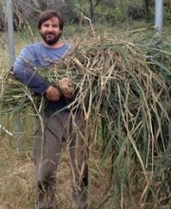
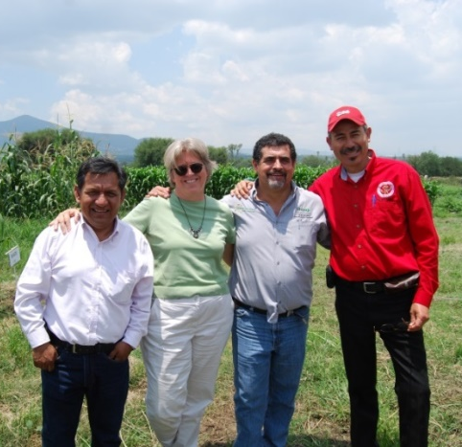


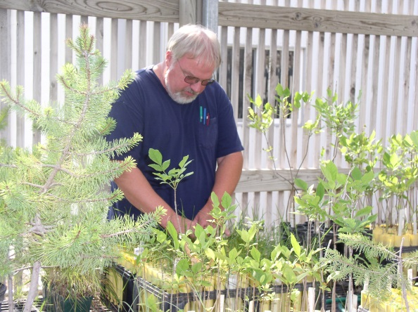


Notes:
mention Tom, Jeremy, Jane, and say it’s funded by the DOE sustainability program
5 years of work by dozens of researchers

Slide 5
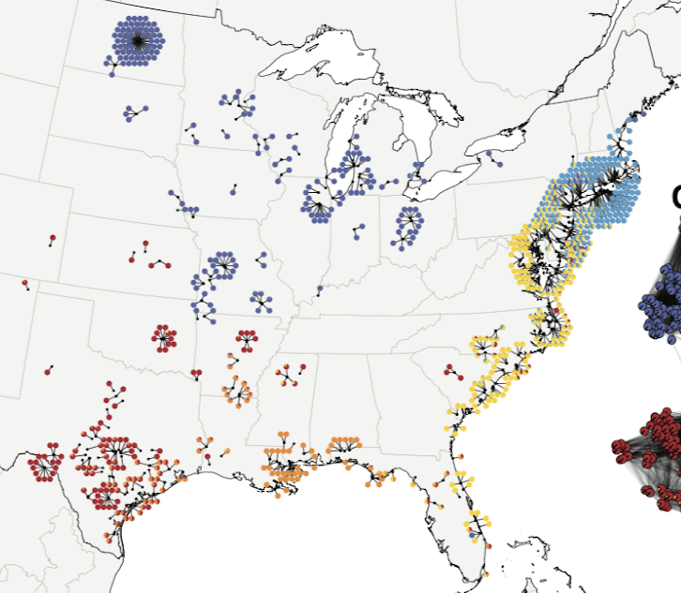
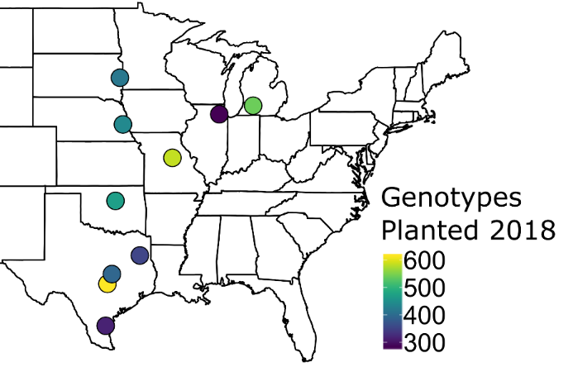
The switchgrass diversity panel was planted in ten common gardens to study adaptation:
Diversity Panel
~700 plants, ~40 million SNPs @ ~45x coverage
Common Gardens
10 U.S. Sites, 17° latitude
Collaborative and community building effort – including involvement of DOE JGI, DOE Bioenergy Centers, CIMMYT, Ladybird Johnson Wildflower Center and many others…..
Notes:
mention Sujan, John on SNPs

Slide 6
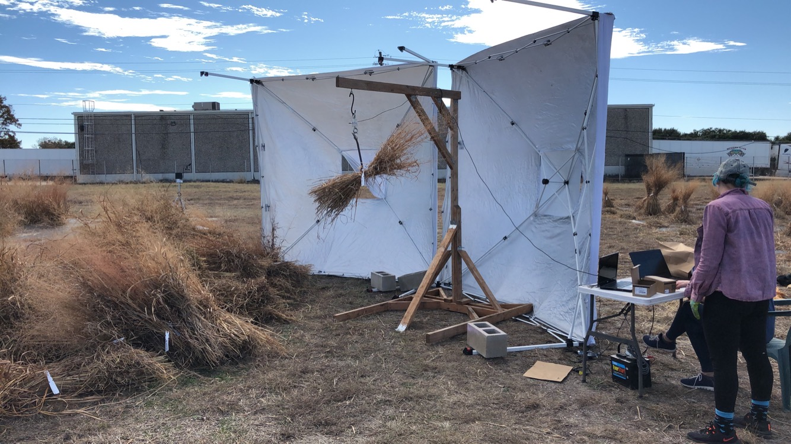
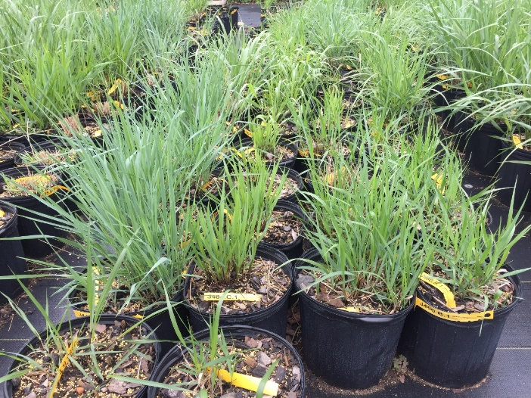
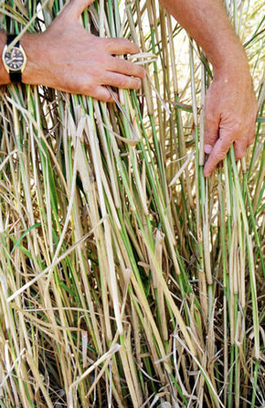
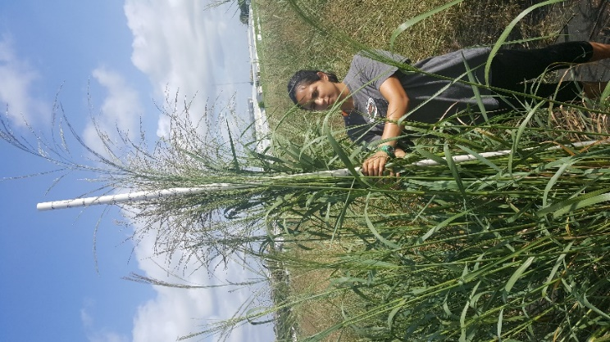
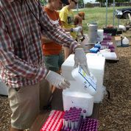
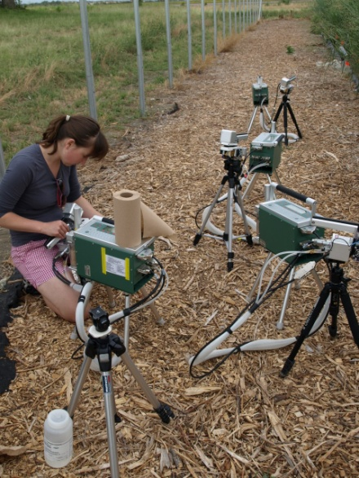

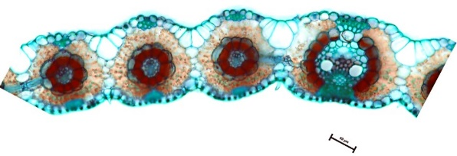
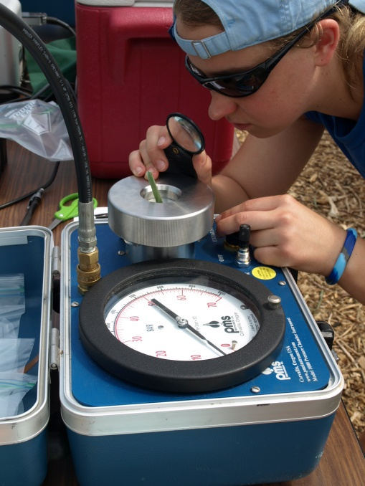
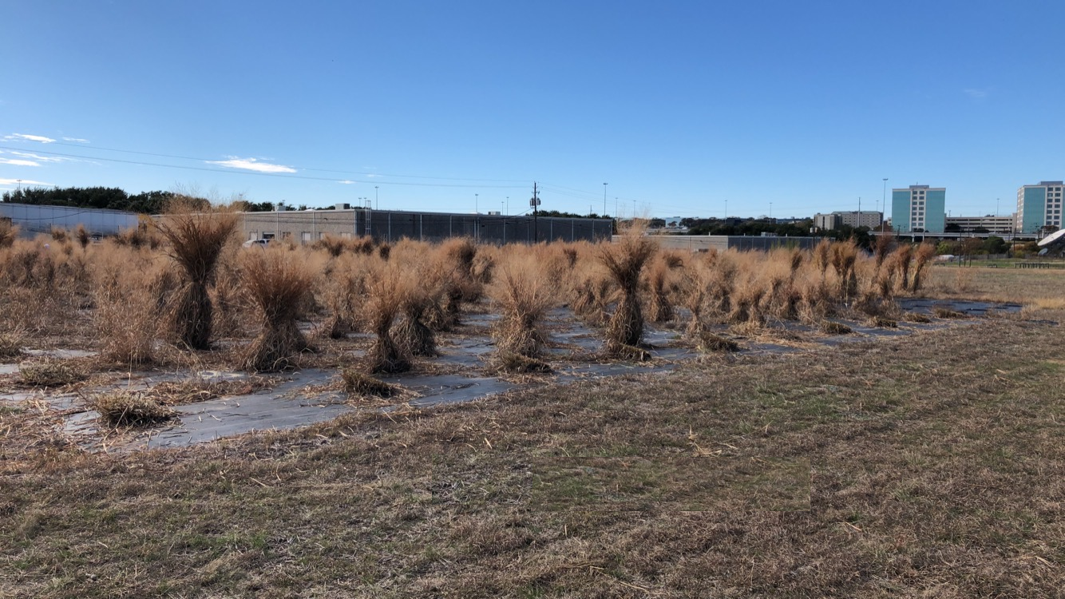

Slide 7
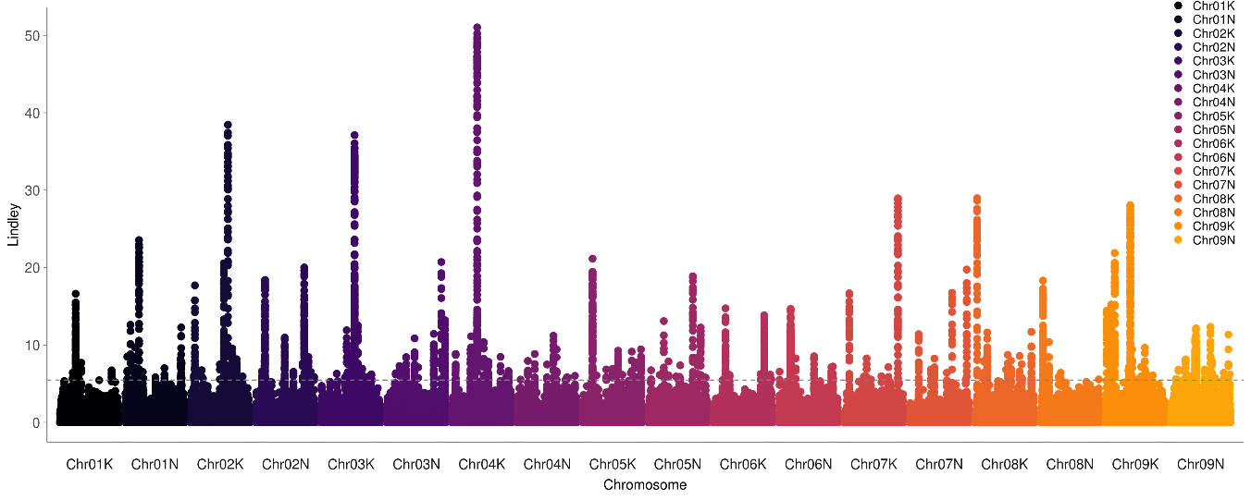
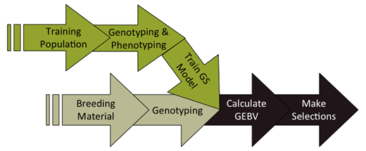
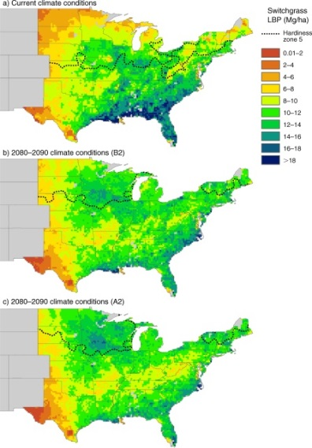
Association & Population Genomic Studies
Genomic Selection & Breeding
Climate Niche Characterization
Agronomic modeling

Slide 8
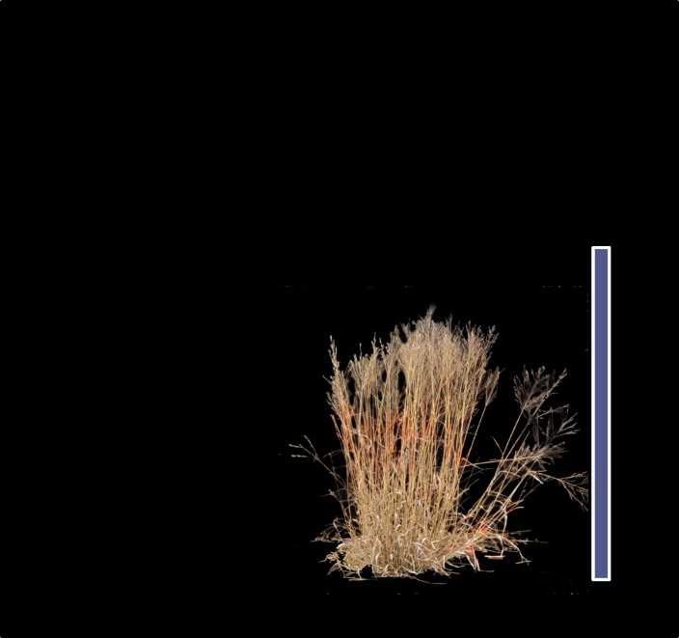
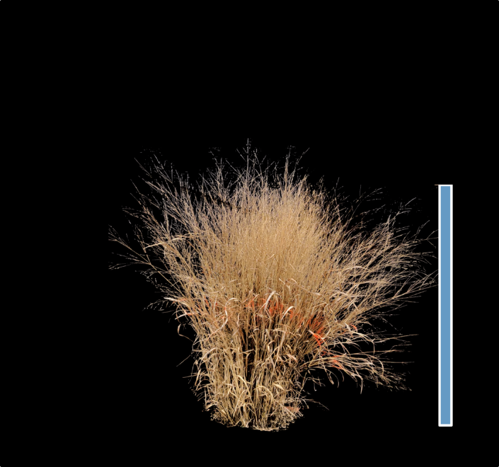
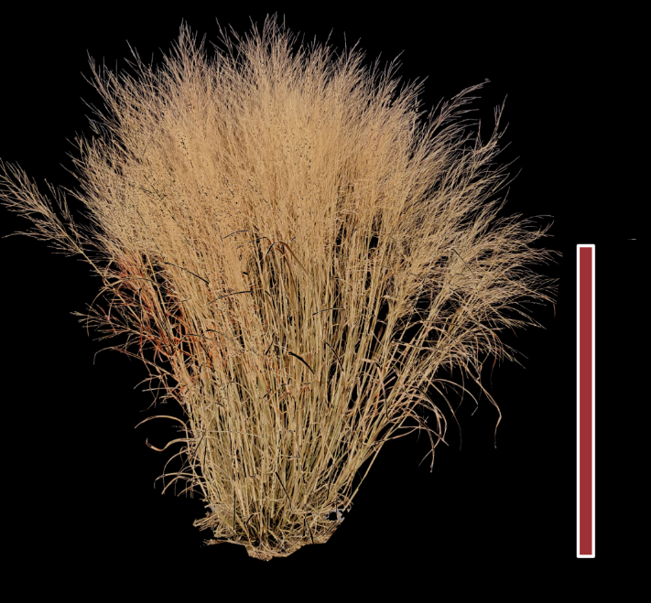
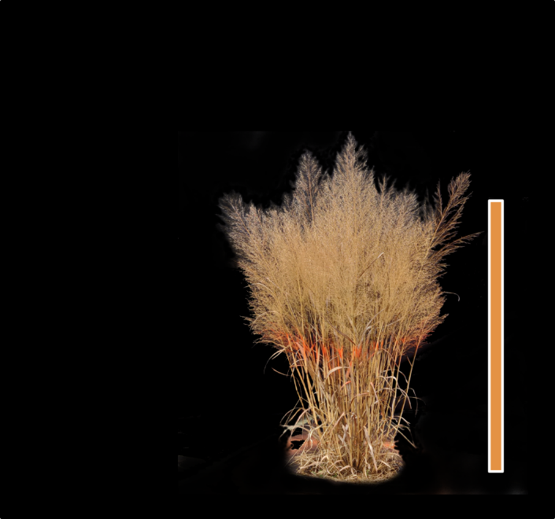
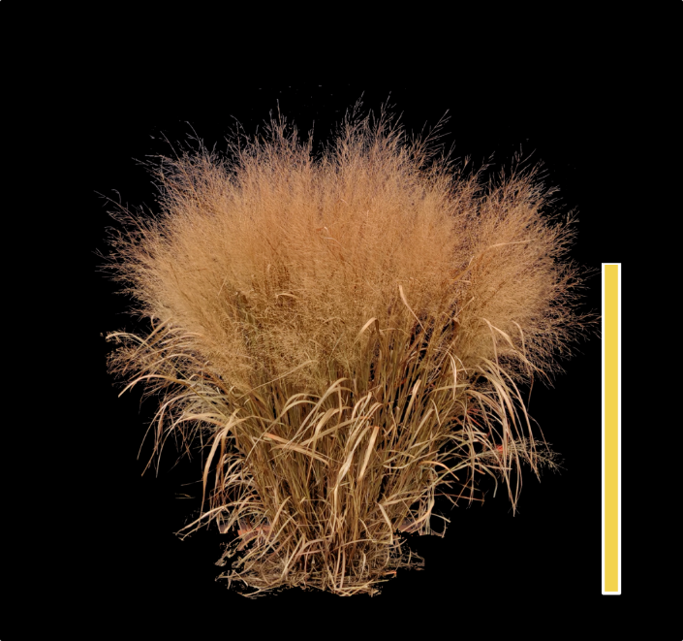
Diversity panel population structure and demography
Northern Upland
Northern Upland
Texas Lowland
Coastal Lowland
Coastal Lowland

Slide 9
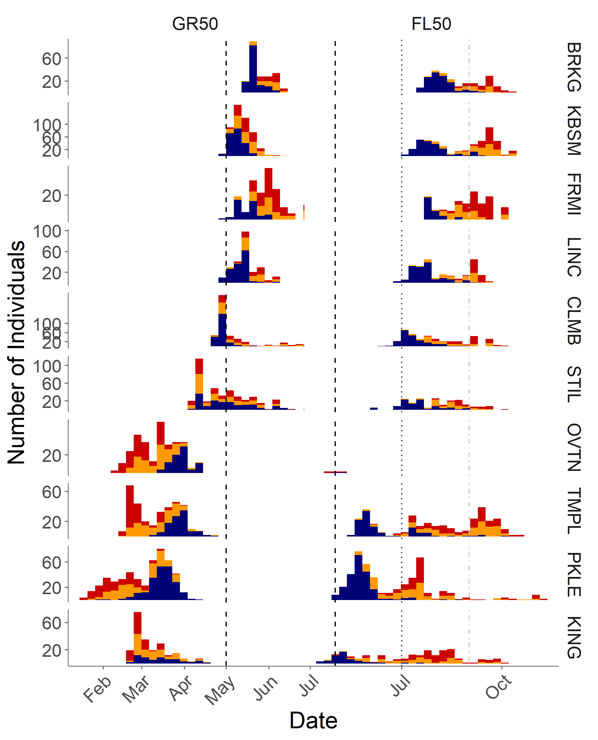
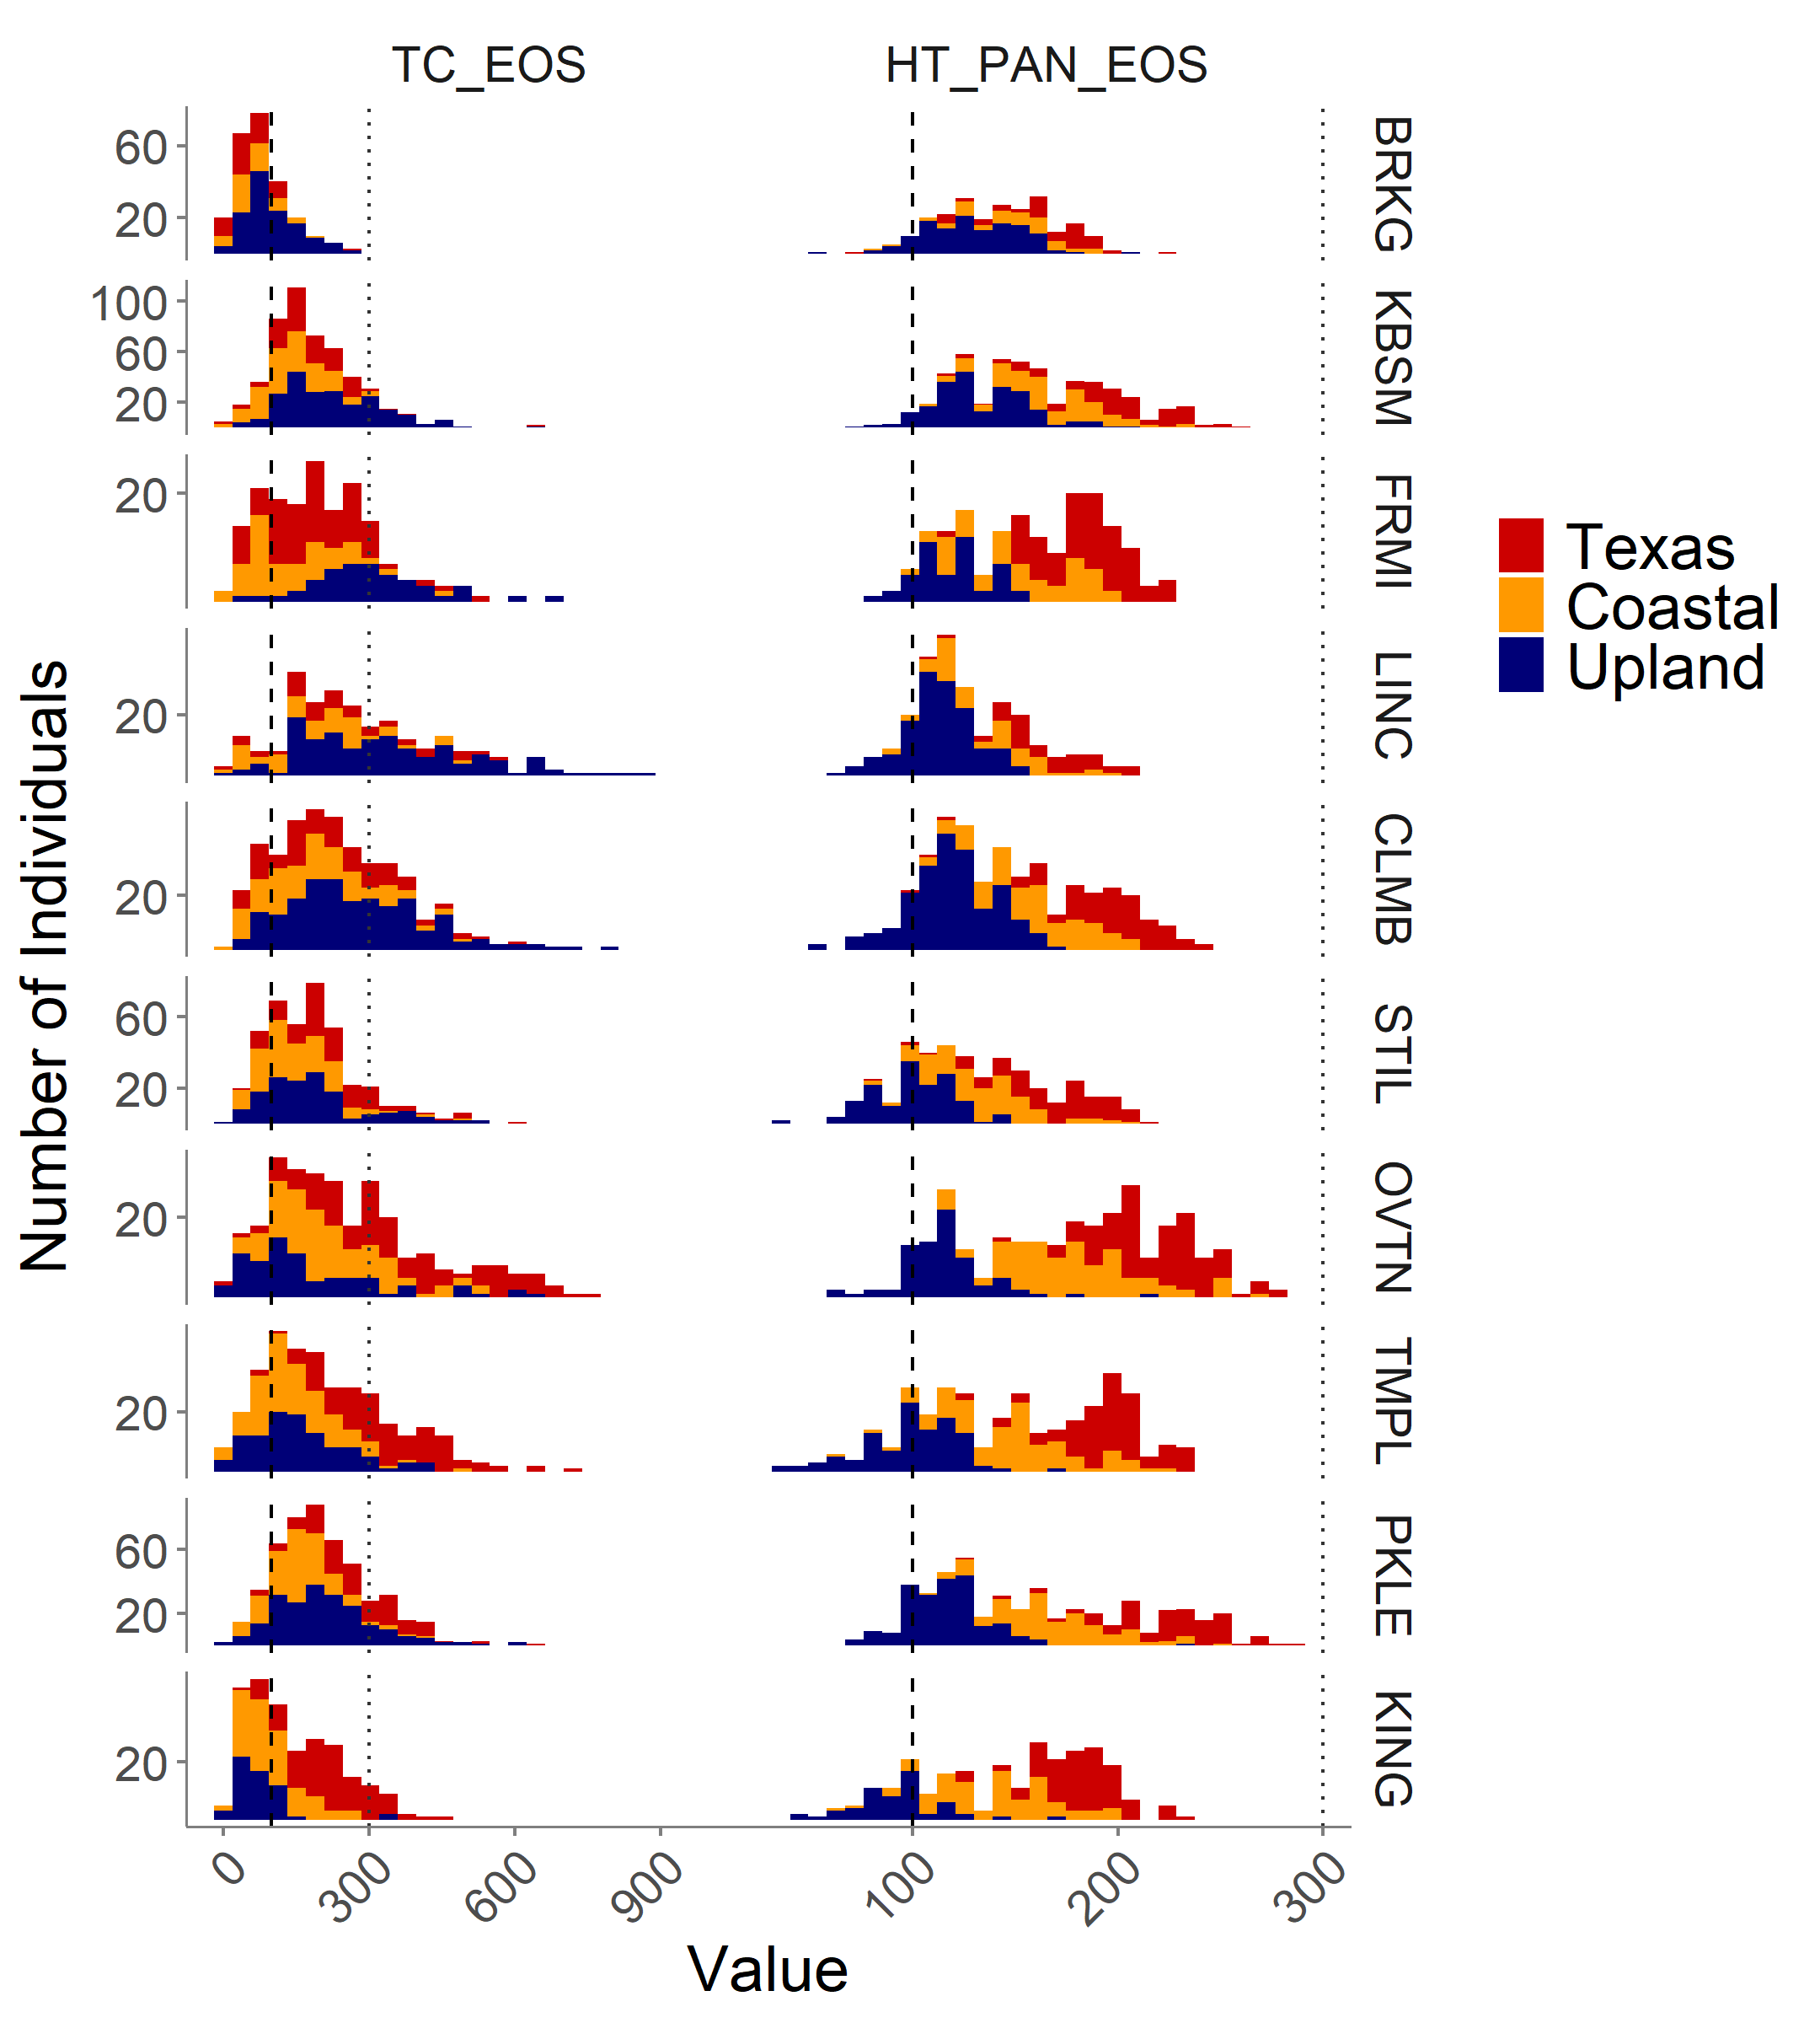
The first of the 2019 diversity panel phenotypic data:
Greenup
Flowering
Tiller Count
Height
Latitude
Notes:
This will be another simplified figure with better axis label sizes

Slide 10
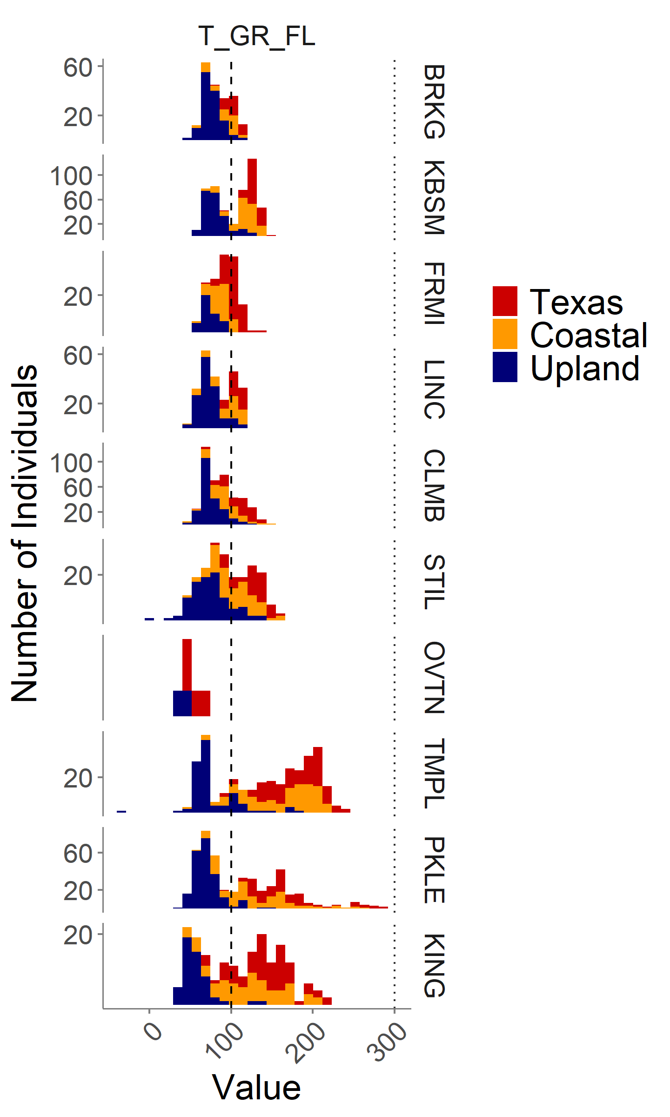
GxE in phenology is visible across the common gardens.
Greenup
Flowering
Days between Greenup and Flowering
Latitude
Notes:
This will be another simplified figure with better axis label sizes

Slide 11
GxE in phenology is visible across the common gardens.
Greenup
Flowering
Days between Greenup and Flowering
Northern germplasm grown in the south has photoperiod sensitivity, leading to early flowering and low biomass.
Southern germplasm grown in the north does not have freezing tolerance and does not survive winter.
Latitude
Notes:
This will be another simplified figure with better axis label sizes

Slide 12
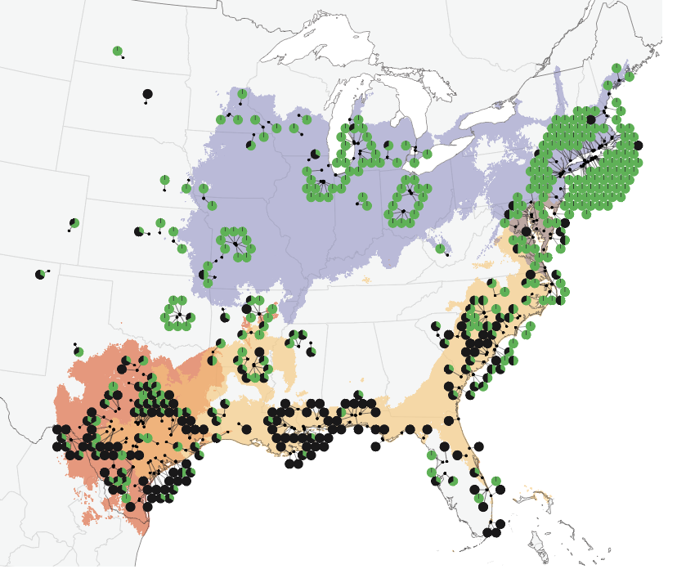
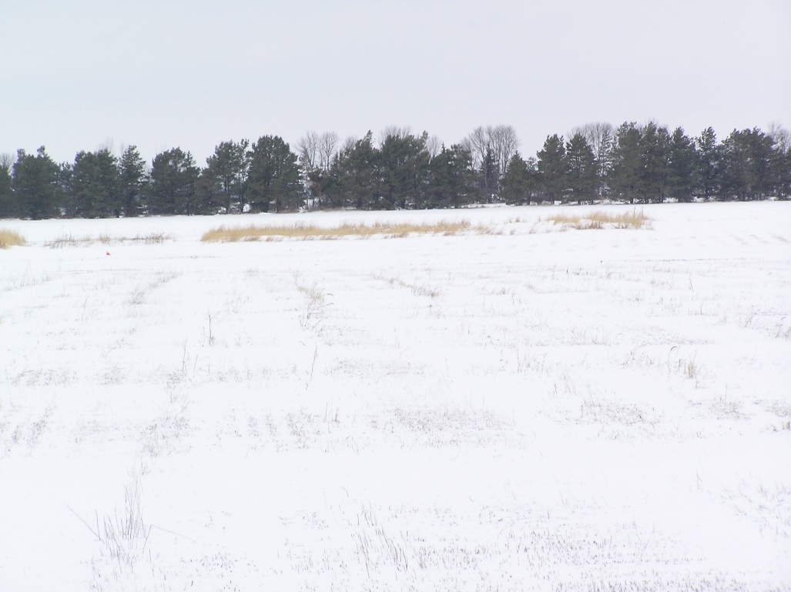
The genetics of GxE in winter survival
Winter 2018 was cold, and we observed considerable winter kill in the north.
Geographic distribution of northern winter kill across germplasm
Brooking SD, 11 degrees F on April 5th

Slide 13
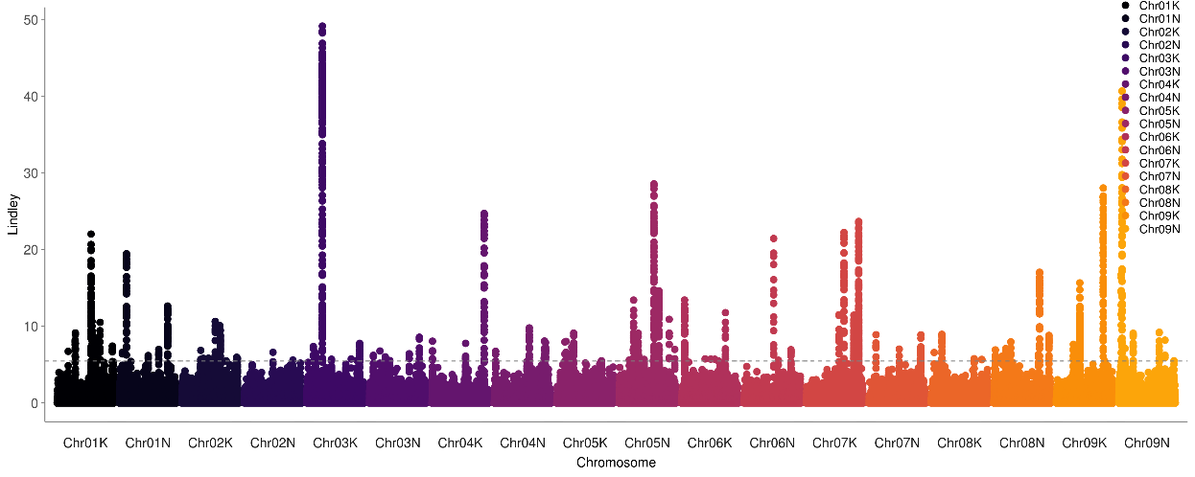
The genetics of GxE in winter survival
Genetic associations for winter survival at four northern sites

Slide 14
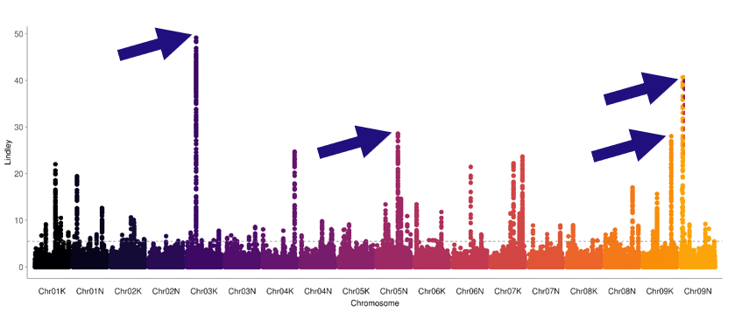
The genetics of GxE in winter survival
Genetic associations for winter survival at four northern sites
Chrom. | Position | Pattern of Allele Frequency | Gene ID | Rice gene annotation
Chr03K | 17.45 Mb | Variable in Texas and Coastal ecotypes | Pavir.3KG320900 (in gene) | MYB family transcription factor, putative, expressed
Chr05N | 44.40 Mb | Variable in Coastal ecotype | Pavir.5NG297500 (in gene) | expressed protein
Chr09K | 58.99 Mb | Variable in Coastal ecotype | Pavir.9KG487700 (in gene) | rhamnose biosynthesis 1 / NAD dependent epimerase protein, expressed
Chr09N | 4.73 Mb | Variable in Texas ecotype | Pavir.9NG075191 (in gene) | aldehyde oxidase, putative, expressed

Slide 15
The genetics of GxE in flowering date
Greenup
Flowering
Days between Greenup and Flowering
The relationship between plant greenup date and flowering date varies more at southern sites than at northern sites
Latitude
Notes:
This will be another simplified figure with better axis label sizes

Slide 16
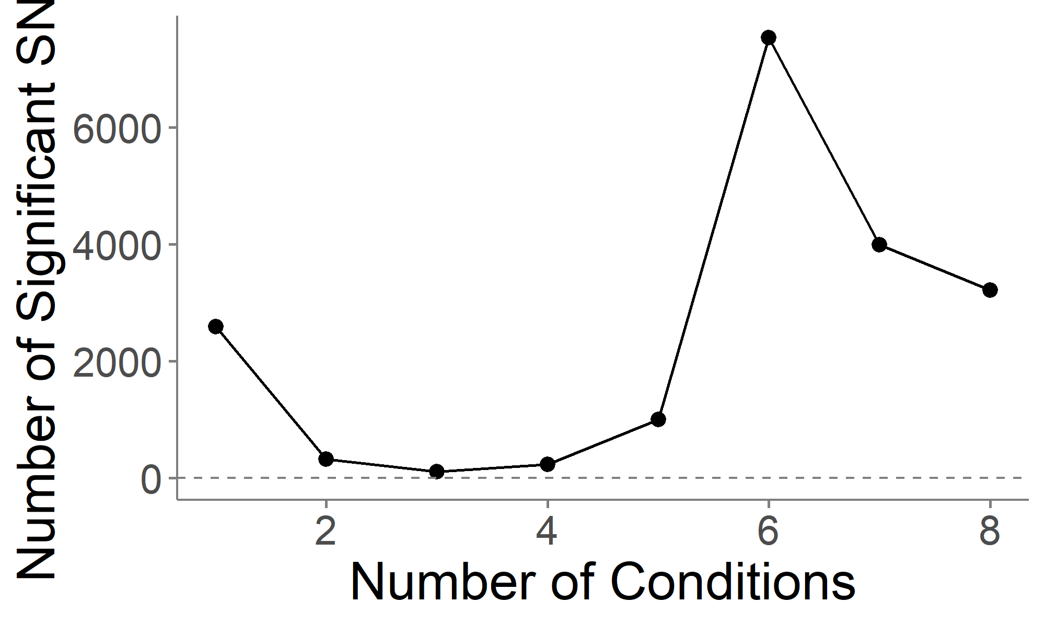
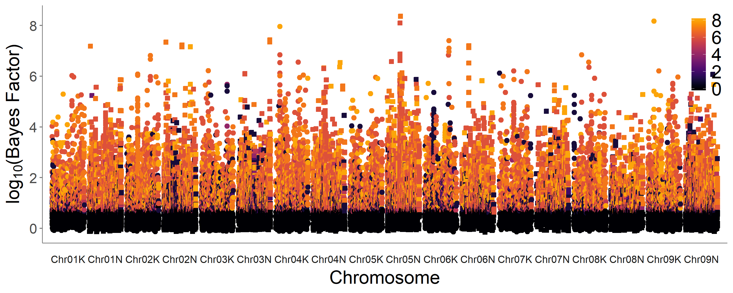
The genetics of GxE in flowering date
“Mashhattan” for Flowering Date

Slide 17
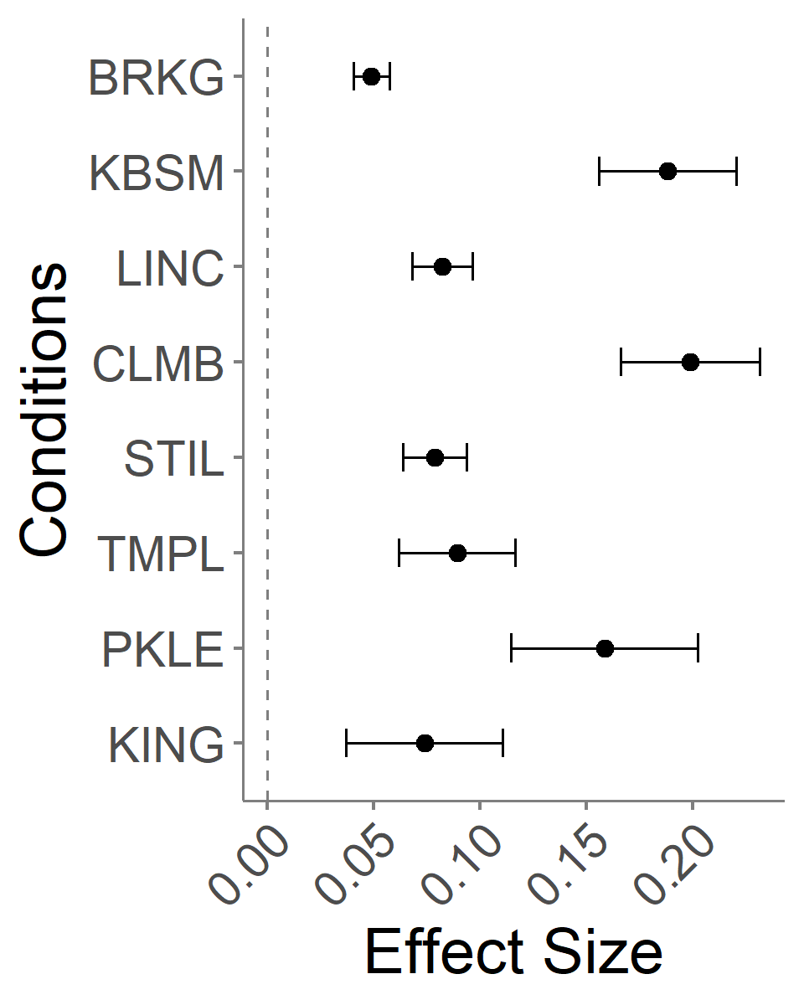
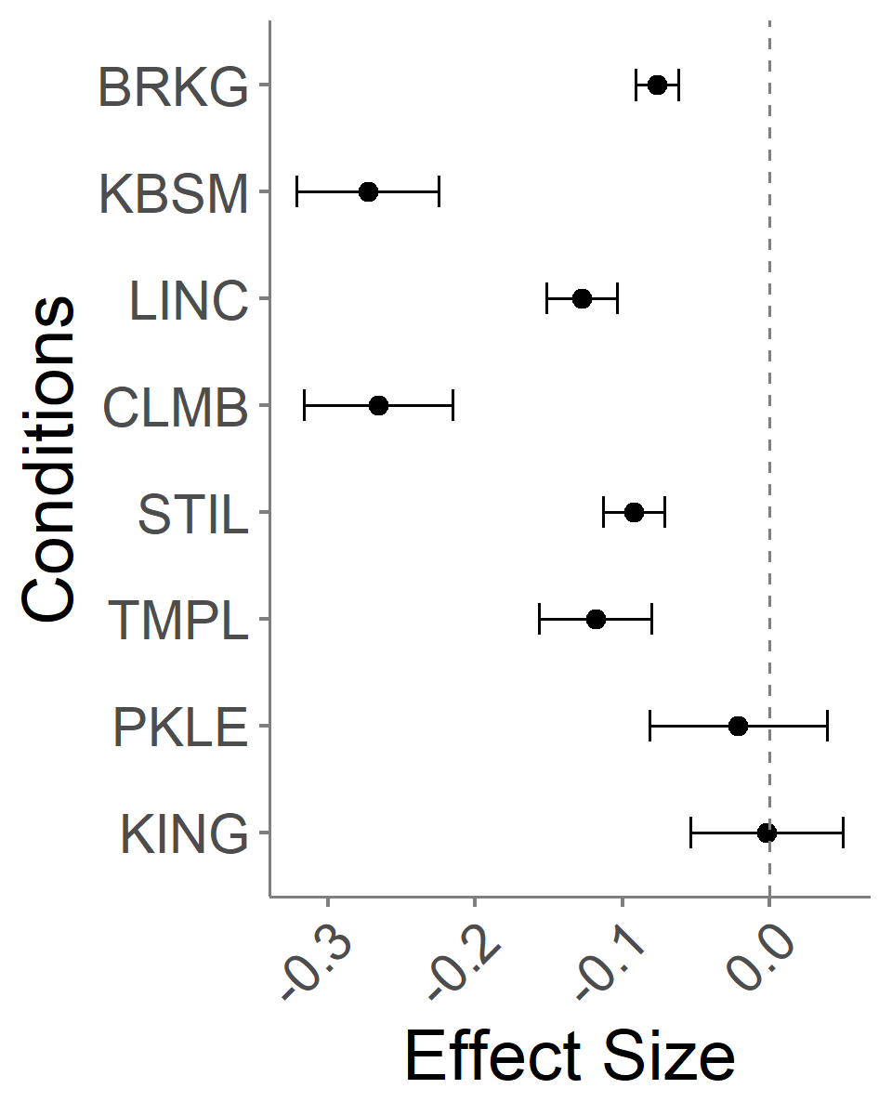
Estimates of effects of single SNPs on flowering date across eight common garden sites.
Chr02N at 57.93 Mb:
Chr05N at 28.31 Mb:
Latitude

Slide 18
Summary and Outlook
Widespread G x E underlies strong patterns of local adaptation
Conditional effects are common
In terms of breeding, we may be able to select stable QTL or stack together conditionally beneficial QTL to minimize tradeoffs and improve general vigor and climate adaptation.
There is more to come: The diversity panel and common gardens will expand available genetic variance and opportunities for studying adaptability and GxE
We hope this resource will be useful to the community and welcome collaborative efforts.

Slide 19




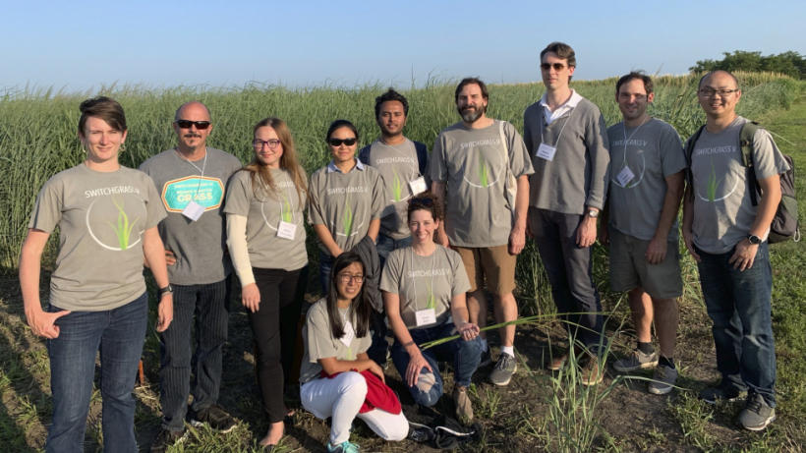
Collaborators
Tom Juenger (UT Austin)
David Lowry (Michigan State University)
Felix Fritschi (Mizzou)
Phil Fay (USDA-ARS, Temple TX)
Jason Bonnette (UT Austin)
Laura Bartley (University of Oklahoma)
John Reilly (USDA-PML, Kingsville TX)
Yanqi Wu (OSU, Stillwater OK)
Monty Rouquette (TAMU-Overton, TX)
Rob Mitchell (USDA-ARS, Lincoln NB)
Arvid Boe (SDSU, Brookings SD)
Kyle Turner
Nathan Pfluger
Matt Donoghue
Chris Bourbois
Jonathan Colen
Sam Lutfy
Marissa Van Damme
Quinn Hiers
Paige Overton
John Row
Joey Budi
Logan Simon
Jeremy Schmutz (JGI/HudsonAlpha)
Jerry Jenkins (HudsonAlpha)
Avinash Sreedasyam (HudsonAlpha)
Sujan Mamidi (HudsonAlpha)
John Lovell (HudsonAlpha)
Shiangqiang Shu (LBL)
Dan Rokhsar (DOE JGI)
Kerrie Barry (DOE JGI)
Funding
DOE Sustainability
JGI CSP
NSF PGRP
DOE Arpa-e
Notes:
big project funded by multiple entities
Kerrie – sample submission
Dan – co-lead at JGI
Shu
Avinash – expression analyses
Jerry – switchgrass annotation

Slide 20
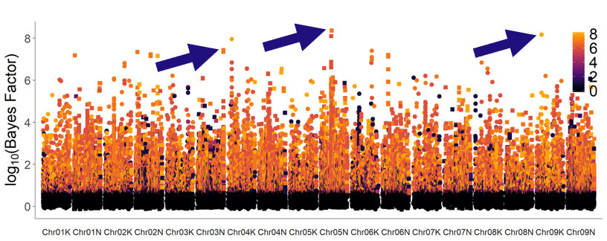
The genetics of GxE in flowering date
Genetic associations for winter survival at four northern sites
Chrom. | Position | Pattern of Allele Effects | Gene ID | Rice gene annotation
Chr03N | 68.10 Mb | Allele effects flowering at 6 northern sites | Pavir.3NG273400 (in promoter) | YABBY domain containing protein, putative, expressed
Chr05N | 29.71 Mb | Allele effects flowering at 6 northern sites | Intergenic
Chr09K | 12.89 Mb | Allele effects flowering date at all sites | Pavir.9K062457 (in gene) | BTBA4 - Bric-a-Brac, Tramtrack, Broad Complex BTB domain with Ankyrin repeat region, expressed
Notes:
Stogios et al. 2005:The BTB domain (also known as the POZ domain) is a versatile protein-protein interaction motif that participates in a wide range of cellular functions, including transcriptional regulation, cytoskeleton dynamics, ion channel assembly and gating, and targeting proteins for ubiquitination. Several BTB domain structures have been experimentally determined, revealing a highly conserved core structure. The BTB domain is typically found as a single copy in proteins that contain only one or two other types of domain, and this defines the BTB-zinc finger (BTB-ZF), BTB-BACK-kelch (BBK), voltage-gated potassium channel T1 (T1-Kv), MATH-BTB, BTB-NPH3 and BTB-BACK-PHR (BBP) families of proteins, among others. BTB-ZF proteins are also known as the POK (POZ and Krüppel zinc finger) proteins. Many members of this large family have been characterized as important transcriptional factors, and several are implicated in development and cancer, most notably BCL6, leukemia/lymphoma related factor (LRF)/Pokemon, PLZF, hypermethylated in cancer (HIC)1 and Myc interacting zinc finger (MIZ)1.
In extant angiosperms, five YABBY subfamilies, FILAMENTOUS FLOWER (FIL or YAB1)/YABBY3 (YAB3 or AFO), CRABS CLAW (CRC), INNER NO OUTER (INO or YAB4), YAB2, and YAB5 [21] are distinguished by conserved functions in the initiation of lamina outgrowth, polarity maintenance, and establishment of the leaf margin [23–25]. Almeida et al. [26] and Morioka et al. [27] have provided evidence for the involvement of the YAB2 and YAB5 genes in the evolutionary diversification of style and filament morphology.

Slide 21
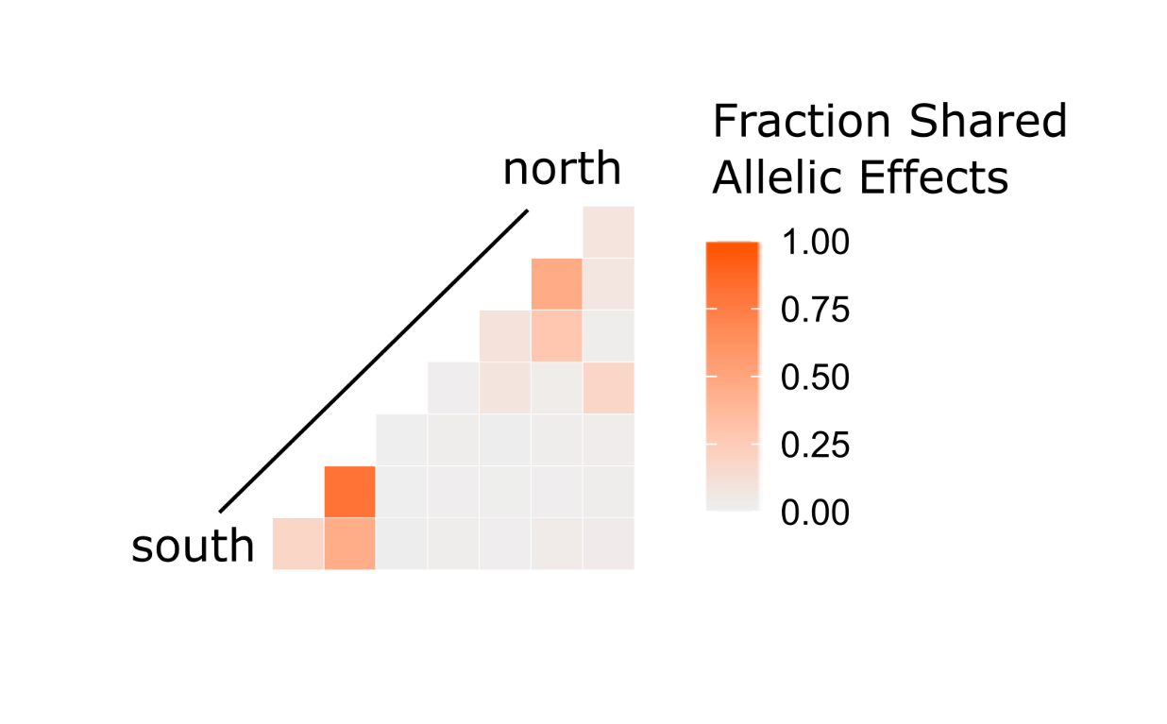
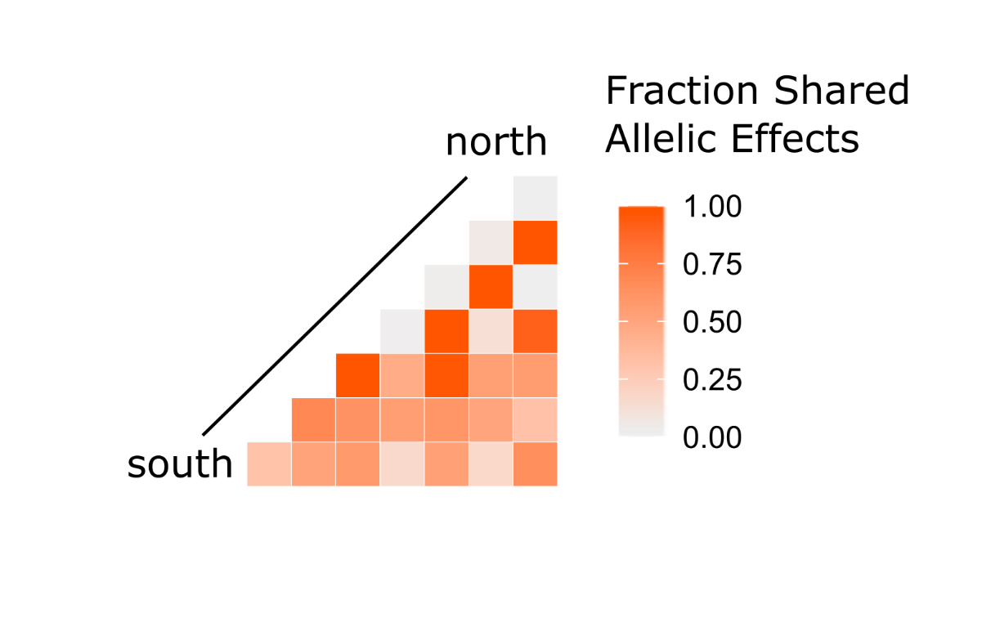
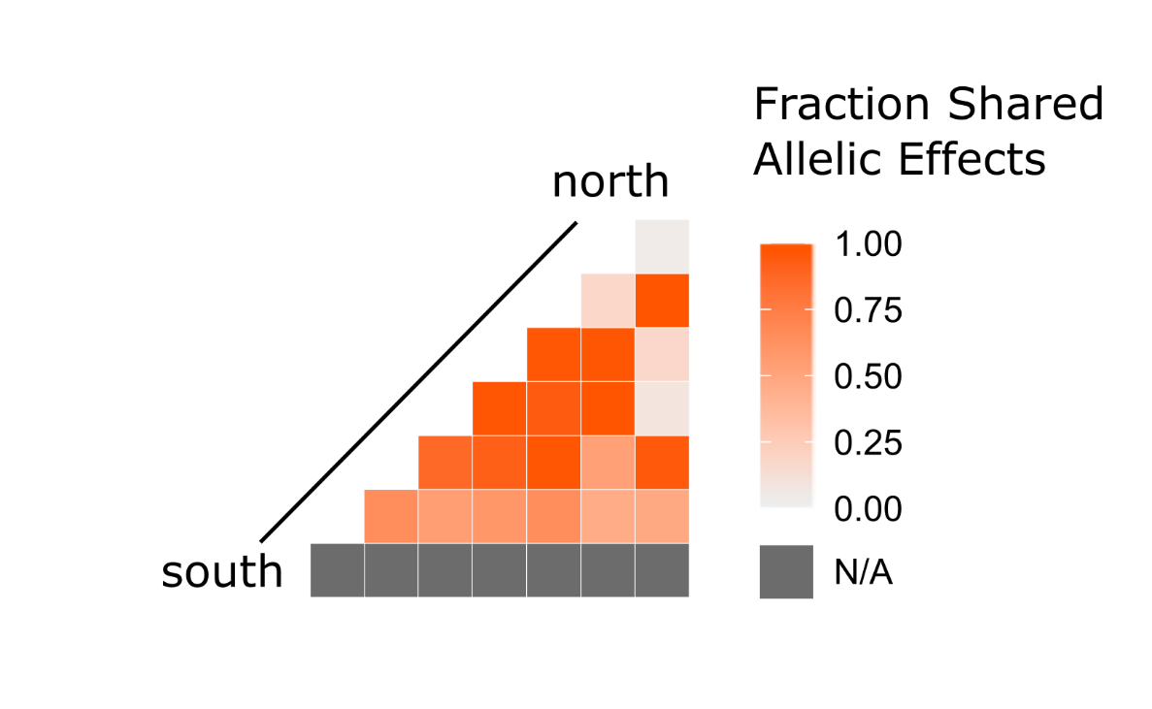
There are similarities in allelic effects on phenology across common garden sites.
Greenup
Flowering
Shared allelic effects on greenup at southern sites
Shared allelic effects on flowering at (western) northern sites
Additional patterns that are unrelated to latitude
Days between Greenup and Flowering

